Slide 1




E-COMMERCE
SHOP
SPHERE
FULL-STACK
PROJECT
By 5

Slide 2


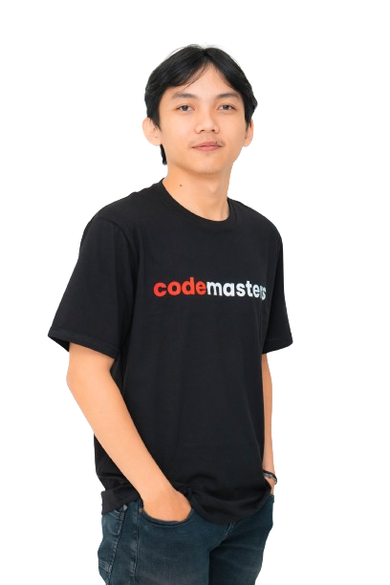


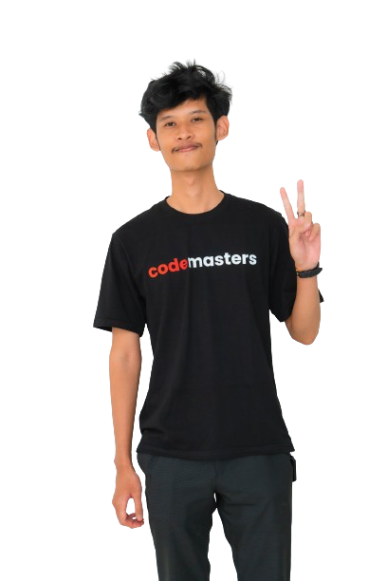


OUR TEAM
SHOP
SPHERE
Triyo
Kristyan Laoli
member
Lead
Ratna Setya N
member
Aziz
member
Fahmi
member

Slide 3

SHOP
SPHERE
WHAT IS IT ?
Shopsphere is a multi-seller e-commerce website that provides products with various categories from various sellers. Users as buyers can search and buy anything on the website from different sellers. As a seller, users can sell some of their products and also manage their products.

Slide 4
FEATURES
SHOP
SPHERE
Login and Register
As a buyers or sellers
- Explore All Products on the Home page.
- Search product by category, name, and other
- Explore All Products on the Home page
- Manage their product
- Manage their account
- Buy some products and add them to the cart.
- Visit the Cart page (read and edit cart)
- Visit the seller transaction page (user order)
- Buy some products and add them to the cart
- Visit Cart page
- Visit the Order page (checkout process)
- Visit the Payment page (payment process)
- Manage their account
- Visit the order page that is specific to the history order as the buyer
-Also can do process payment

Slide 5


TECHNOLOGIES USED
SHOP
SPHERE
Backend
Node js
Express js
Prisma ORM
MySQL
Frontend
React js
Tailwind CSS
Third-party API
Https://rajaongkir.com
Https://stripe.com

Slide 6
SHOP
SPHERE
Live Demo >>

Slide 7

SHOP
SPHERE
THANK
YOU

